Slide 1

Oil Mill Management System
A comprehensive Java-based domain model for managing industrial oil extraction operations, batch processing, quality control, and customer delivery workflows.

Slide 2


About Myself
Name: Vineesha Kolla
Course: B. Tech – Computer Science and Engineering
College: Prasad V. Potluri Siddhartha Institute of Technology
Technical Skills: Java, Python, C
Interests: Problem Solving, Software Development, Real-world Automation Projects
Project Inspiration
The idea for my project, “Oil Mill Management System,” was inspired by my family’s traditional oil mill.Seeing the manual work in tracking batches and efficiency motivated me to create a digital solution to automate and simplify the process.This project showed me how technology can modernize traditional industries and make everyday operations more efficient.

Slide 3

Project Description
The Oil Mill Management System is a Java-based application that automates and manages various activities in an oil mill. Traditionally, oil mills maintain handwritten records of seed batches, oil extraction quantities, and customer deliveries. This manual process often leads to inefficiencies such as inaccurate data recording, poor inventory management, and difficulty in tracking production efficiency.
To overcome these limitations, the Oil Mill Management System has been designed to digitize and streamline mill operations, allowing users to easily manage production batches, monitor efficiency, schedule deliveries, and generate customer bills — all through a structured, menu-driven console interface.
This system makes use of Object-Oriented Programming (OOP) principles, Java Collections Framework, and Multithreading to simulate real-time industrial operations and analysis in a modular and maintainable way.

Slide 4
Problem Statement
Manual Operations
Quality Control Gaps
Billing Complexity
Oil mills rely on paper-based records and spreadsheets, making batch tracking, quality monitoring, and inventory management time-consuming and error-prone.
Without automated efficiency monitoring, low-performing batches go undetected, resulting in wasted resources, contaminated stock, and reduced profitability.
Managing multiple customer orders, delivery schedules, and billing calculations manually leads to disputes, delays, and revenue tracking issues.
Notes:
Manual operations in oil mills rely on paper-based records and spreadsheets, making batch tracking, quality monitoring, and inventory management time-consuming and error-prone. Without automated efficiency monitoring, low-performing batches go undetected, resulting in wasted resources, contaminated stock, and reduced profitability. Managing multiple customer orders, delivery schedules, and billing calculations manually leads to disputes, delays, and revenue tracking issues.

Slide 5
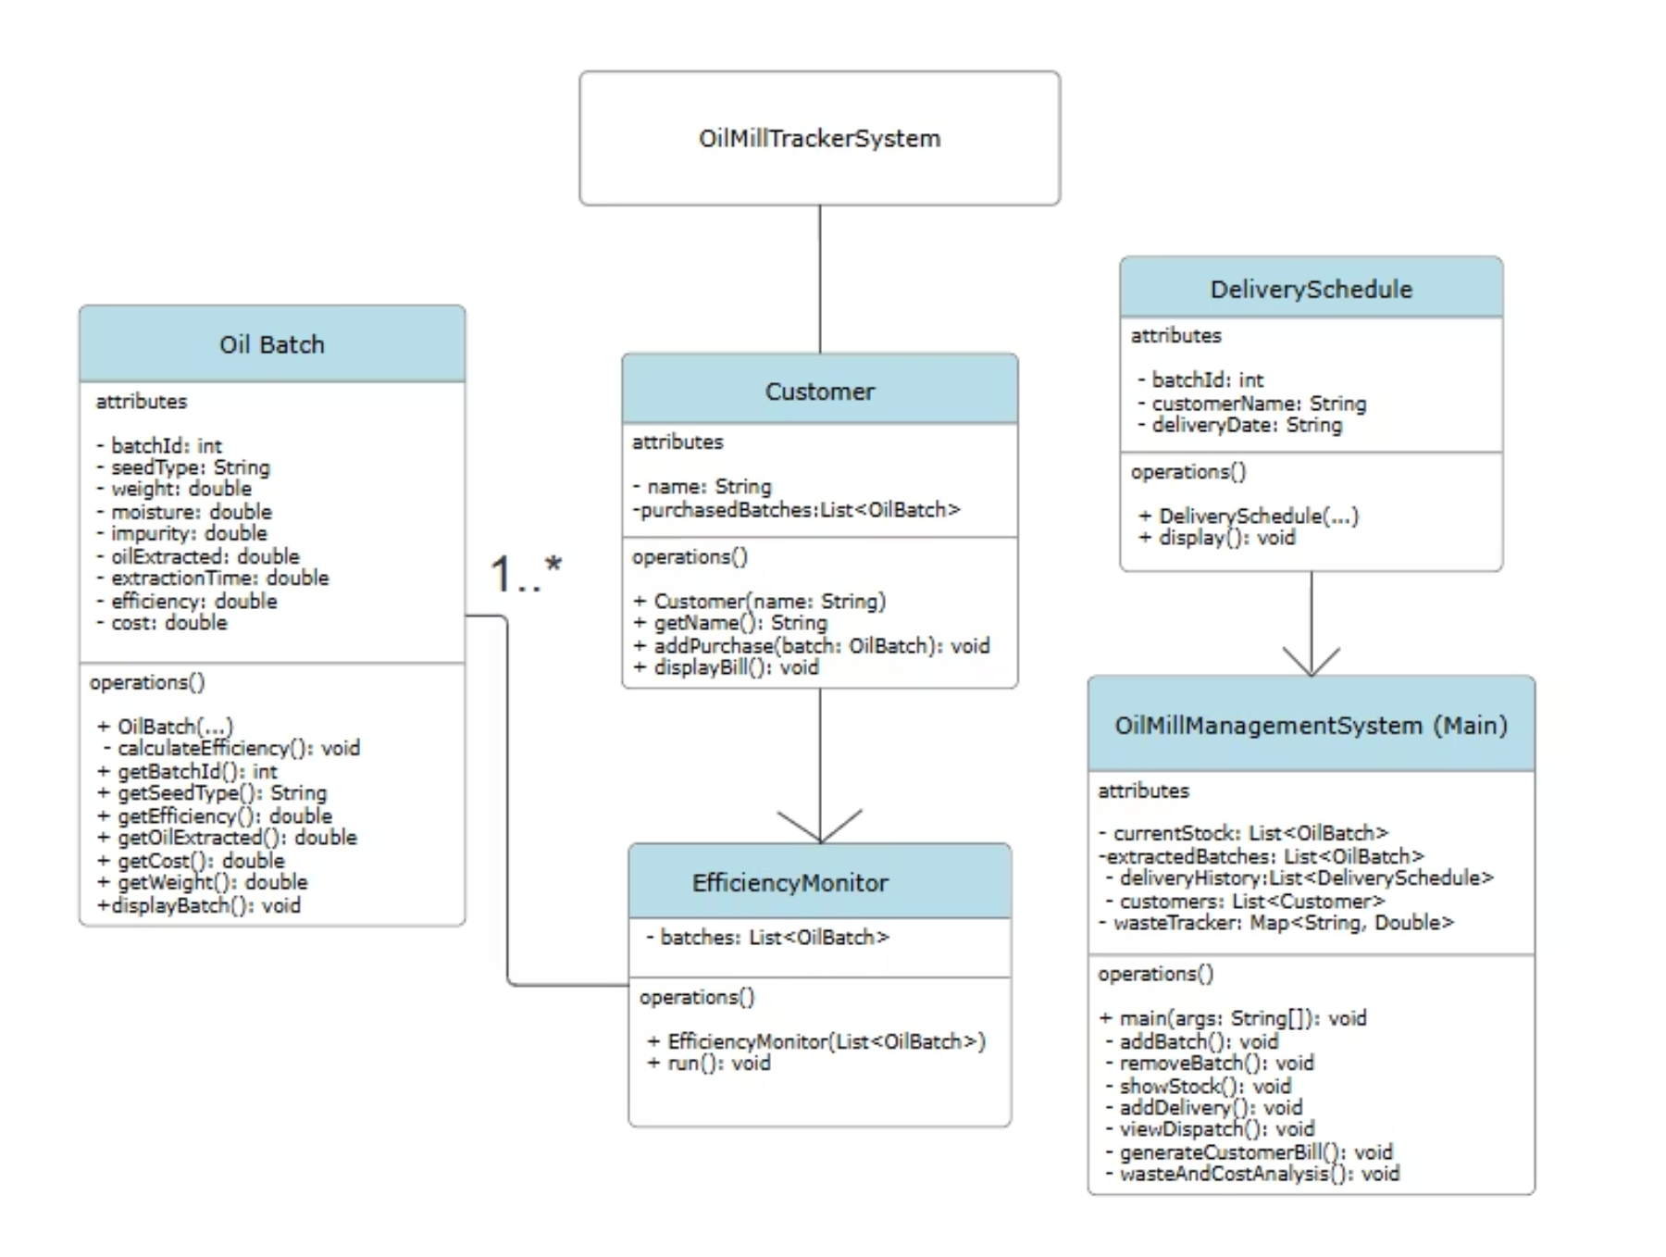
UML Diagram for the Program

Slide 6
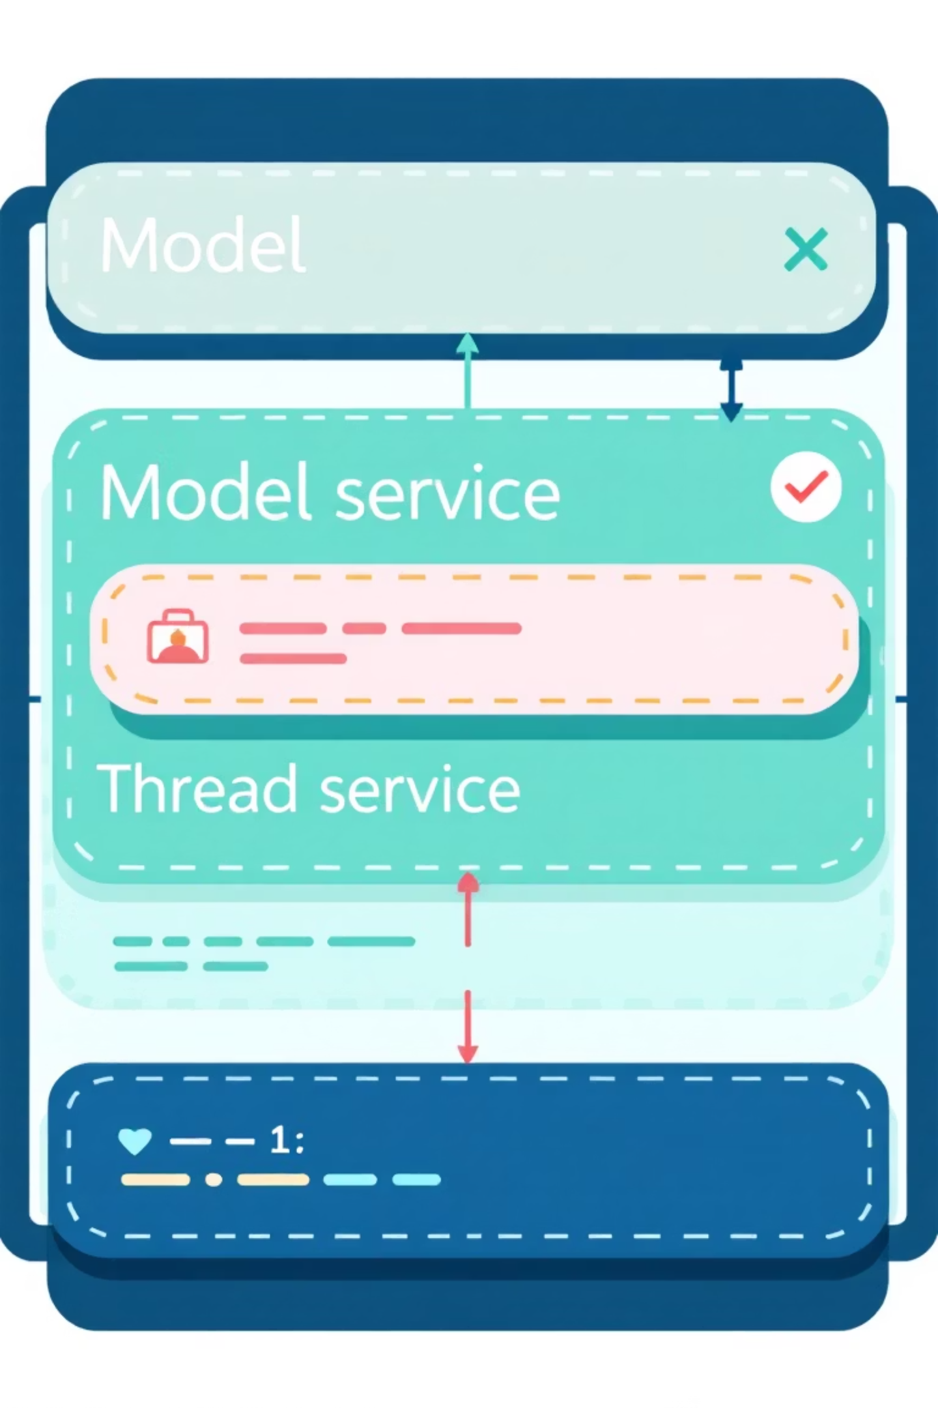
System Architecture & Design
Package Structure: The system follows a layered architecture with model/ (domain entities), thread/ (concurrent processing), and service/ (business logic orchestration). This separation ensures maintainability, testability, and clear responsibility boundaries.

Slide 7
Core Domain Model
1
2
3
OilBatch
Customer
DeliverySchedule
Represents a single batch of oil with attributes: batchId (auto-incremented), seedType, weight, moisture, impurity, oilExtracted, extractionTime, efficiency (calculated), and cost. Includes displayBatch() method for reporting.
Manages customer information and purchase history. Maintains a list of purchased batches and provides displayBill() for generating itemised invoices with totals.
Tracks delivery logistics: batchId, customerName, and deliveryDate. Provides display() method for dispatch history reporting.

Slide 8




Key Features & Workflows
Add Batch
Remove & Extract
Input seed type, weight, moisture, impurity, oil extracted, time, cost; auto-generates batchId and calculates efficiency.
Move processed batches from current stock to extracted batches list, triggering efficiency monitoring.
Schedule Delivery
Generate Billing
Link extracted batches to customers, set delivery dates, and maintain dispatch history for traceability.
Aggregate customer purchases by batch, calculate totals, and produce itemised bills with cost breakdowns.

Slide 9
Analysis & Reporting
n
n
n
Efficiency Calculation
Waste Analysis
Cost Per Litre
Efficiency = (Oil Extracted / Weight) × 100; alerts triggered if below 30% threshold.
Total Waste = Total Weight − Total Oil; percentage calculated for seed-type comparisons and optimization.
Metric = Total Production Cost / Total Oil; enables pricing strategy, profitability analysis, and supplier negotiations.
The system validates data integrity, detects anomalies (oil extracted exceeding seed weight), and provides actionable insights for continuous improvement.

Slide 10

Implementation Benefits
Scalability – Easily extend with database integration, REST APIs, and web UI without restructuring core model.
Reliability – Thread-safe operations, exception handling, and automated alerts reduce human error and downtime.
Maintainability – Clear separation of concerns, intuitive class design, and comprehensive domain logic simplify future updates and debugging.

